Slide 1
It’s a process of planning a software system where objects will interact with each other to solve specific problems. The saying goes, "Proper Object oriented design makes a developer's life easy, whereas bad design makes it a disaster.
Object Oriented Design and Development Principles

Slide 2
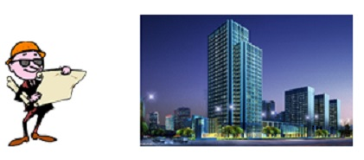
How does anyone start?
When anyone starts creating software architecture their intentions are good. They try to use their existing experience to create an elegant and clean design.

Slide 3

How it ends?
Over time software starts to rot. With every feature request or change software design alters its shape and eventually the simplest changes to application requires a lot of effort and, more importantly, creates higher chances for more bugs.

Slide 4
Change is inevitable
Changes are an integral part of the software world. Obviously because clients are paying they will demand for what they are expecting. So we cannot blame "change" for the degradation of software design. It is our design which is at fault.

Slide 5
Solution?
Software architecture: like MVC, 3-Tier, MVP tells us how overall projects are going to be structured.
Design pattern: allows us to reuse the experience or rather, provides reusable solutions to commonly occurring problems. Example – an object creation problem, an instance management problem, etc.
Principles: tell us, do these and you will achieve this. How you will do it is up to you. Everyone defines some principles in their lives like, "I never lie," or, "I never drink alcohol," etc. He/she follow these principles to make his/her life easy, but how will he/she stick to these principles is up to the individual.

Slide 6
What are Software Design Principles?
Software design principles represent a set of guidelines that helps us to avoid having a bad design. The design principles are associated to Robert Martin who gathered them in "Agile Software Development: Principles, Patterns, and Practices". According to Robert Martin there are 3 important characteristics of a bad design that should be avoided:

Slide 7
Design smells
Rigidity
Software is difficult to change
Fragility
Program breaks in many places when a change made in a single place
Immobility
Parts could be useful in other systems, but effort and risk to separate from original system is too great

Slide 8
SOLID
Single Responsibility Principle (SRP)
Open-Closed Principle (OCP)
Liskov Substitution Principle (LSP)
Interface Segregation Principle (ISP)
Dependency Inversion Principle (DIP)

Slide 9
Single Responsibility Principle (SRP)
A class should have only one reason to change

Slide 10
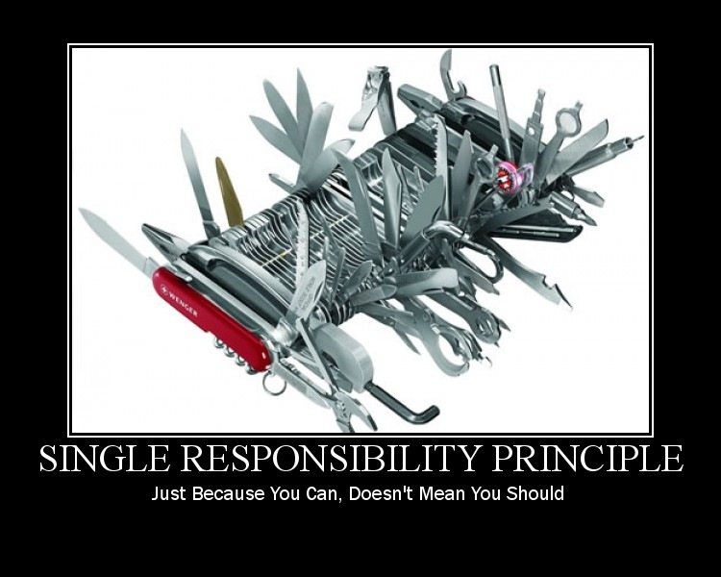

Slide 11
Responsibility
What a class does
The more a class does, the more likely it will change
The more a class changes, the more likely we will introduce bugs

Slide 12
Open Closed principle (OCP)
Software entities (classes, modules, functions, etc.) should be open for extension but closed for modification

Slide 13
Conforming to OCP
Open for extension
Behavior of the module can be extended
We are able to change what the module does
Closed for modification
Extending behavior does not result in changes to source, binary, or code of the module

Slide 14
Liskov Substitution Principle (LSP)
Subtypes must be substitutable for their base types

Slide 15
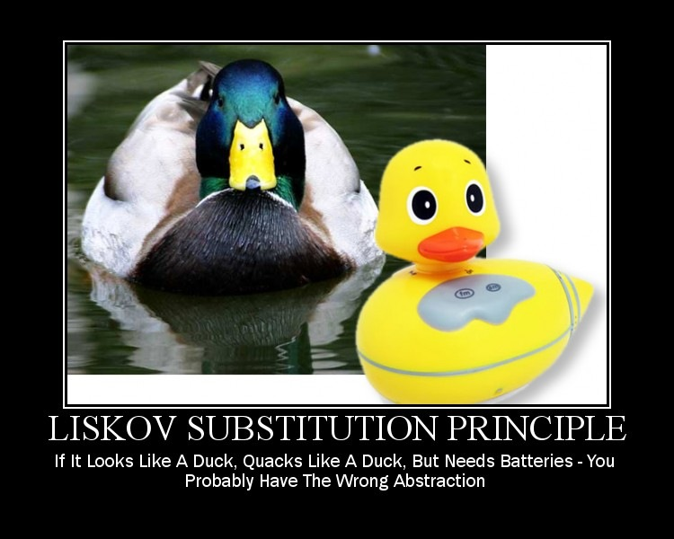

Slide 16
IS-A
Basic OOP discusses inheritance with “IS-A”
LSP says that “IS-A” refers to behavior
Behavior is what software is really all about

Slide 17
Interface Segregation Principle (ISP)
Clients should not be forced to depend on methods they do not use

Slide 18
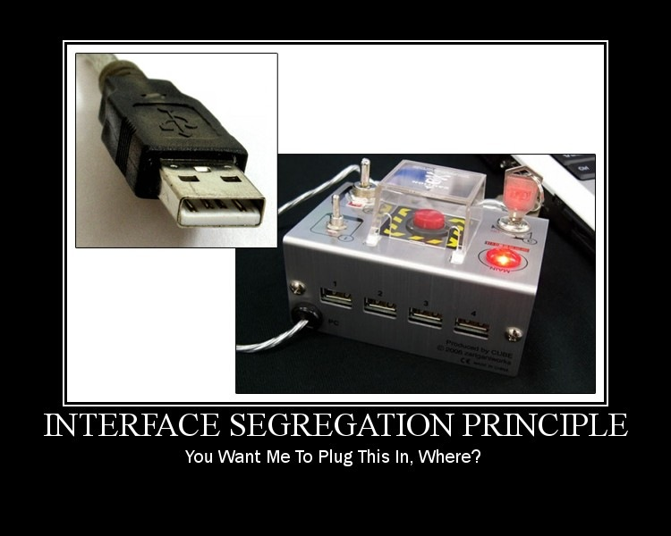

Slide 19
Dependency Inversion Principle (DIP)
High-level modules should not depend on low-level modules. Both should depend on abstractions
Abstractions should not depend on details. Details should depend upon abstractions

Slide 20
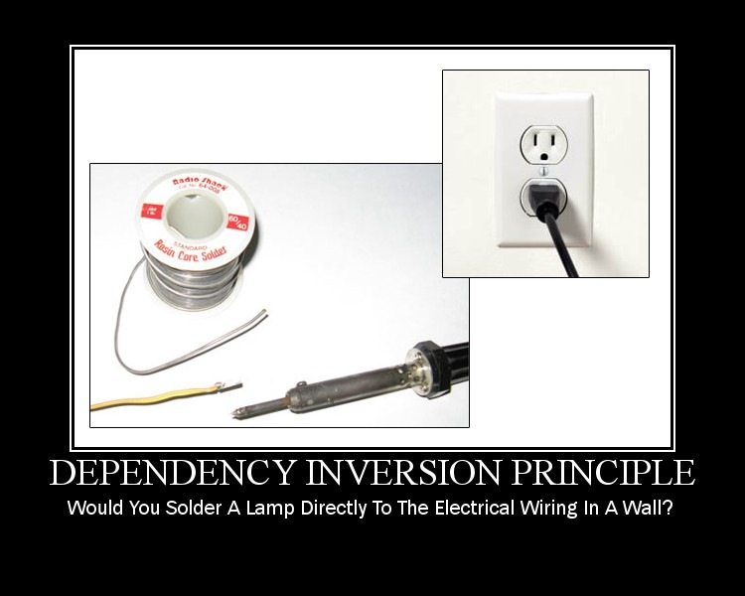

Slide 21
Other Design and Development Principle

Slide 22
DRY
(Don't repeat yourself)
The DRY principle is stated as "Every piece of knowledge must have a single, unambiguous, authoritative representation within a system."

Slide 23
YAGNI
(You aren't gonna need it)
This is a principle of extreme programming (XP) that states a programmer should not add functionality until deemed necessary.

Slide 24
KISS
(Keep it simple, stupid)
The KISS principle states that most systems work best if they are kept simple rather than made complicated; therefore simplicity should be a key goal in design and unnecessary complexity should be avoided

